Slide 1
Safe Harbor Statement
The analyst in this presentation are not financial advisers or brokers and do not offer financial advice based on your personal financial situation or goals and shall not be held liable for any investment or trading losses you may incur by using the information provided. This includes your trading the stocks mentioned on the Internet, various Internet chat rooms, message boards, video charts, in daily or weekly alerts or any other company publications. None of the information contained on messages in various Internet chat rooms, message boards, video charts, in daily or weekly alerts or any other company publications constitutes a recommendation to buy or sell a particular security. The content provided by the company is provided solely as an informational aid to your investment research and all investment decisions are solely the responsibility of the user. The information contained in any alerts, various Internet chat rooms, video charts, and other materials offered is believed to be accurate; however, we make no warranties or guarantees to its accuracy. All information is taken from SEC filings, company websites and Internet search engines and is believed to be deemed accurate and we take no responsibility if the information was not accurate and up to date.

Slide 2
Executive Summary
Our non-statistical sampling suggested equity markets initially overreact to unfavorable corporate news events of any one equity
We believe there are two key contributing factors:
Emotion, Not Rational Logic, Determines the Stock Market
“People generally feel twice as much sadness or pain when something is lost than when something of equal value is gained. This is the main reason why stocks go down faster than they go up”
Technology
Mobile and automated technology has not only enabled news to propagate quickly but companies, individuals and bots to transact on that news instantly
Source: https://www.psychologytoday.com/blog/wired-success/201309/emotion-not-rational-logic-determines-the-stock-market
Why Stocks Tend To Decline Much Faster Than They Rise; http://theemotionallyintelligentinvestor.com/?p=145

Slide 3
Executive Summary
The market reaction to an unfavorable news ‘event’ typically causes a dramatically steep and rapid decline in price value
This is perpetuated until the risk is assessed and the security is viewed as ‘undervalued’
Then the ‘smart money’ begins buying into the shares allowing a visible recovery to be seen, without having to be predicted

Slide 4
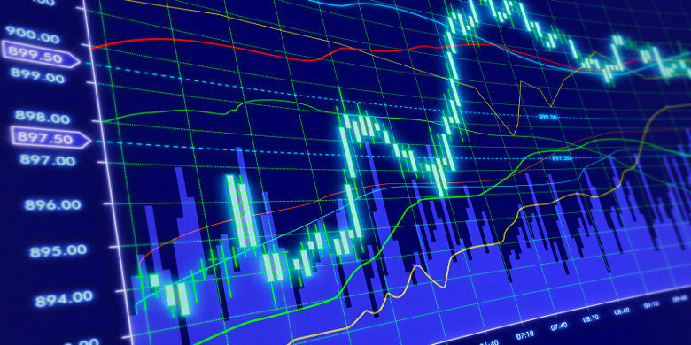
The Bounce
An analysis of the emotional stock volatility to corporate news worthy events and the buying opportunity and returns they present
Jan 24, 2018
Harshil Patel, Sean Slavin, Craig Bauer, Mariah McLaughlin

Slide 5
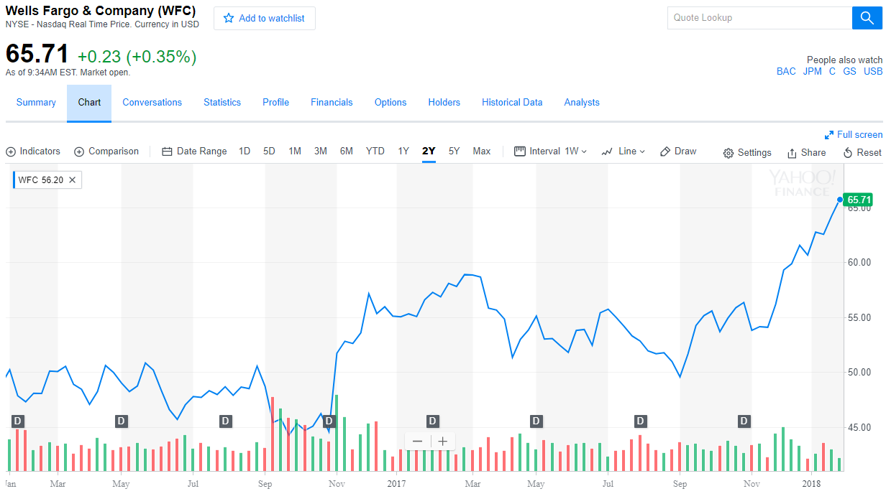
Product Failure, Service Failure or Fraudulent Practice
Sep 8, 2017 Wells Fargo: Consumer Financial Protection Bureau and the Los Angeles City Attorney and the Office of the Comptroller of the Currency fine $185 million for opening up over 2 million fake bank and credit card accounts in customers’ names without their knowledge or consent.

Slide 6
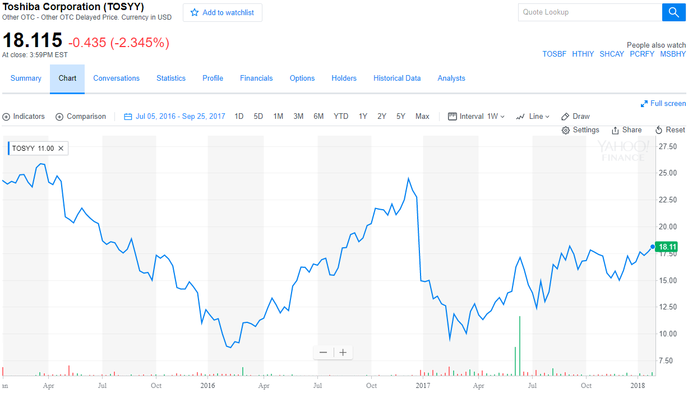
Accounting and Finance Misrepresentation
December 28, 2016 Toshiba’s U.S. nuclear-power subsidiary Westinghouse acquired CB&I Stone & Webster when Toshiba (TOSBF) was still struggling to recover from a $1.2 billion accounting scandal, then warned it is expecting billions of dollars in losses from its takeover

Slide 7
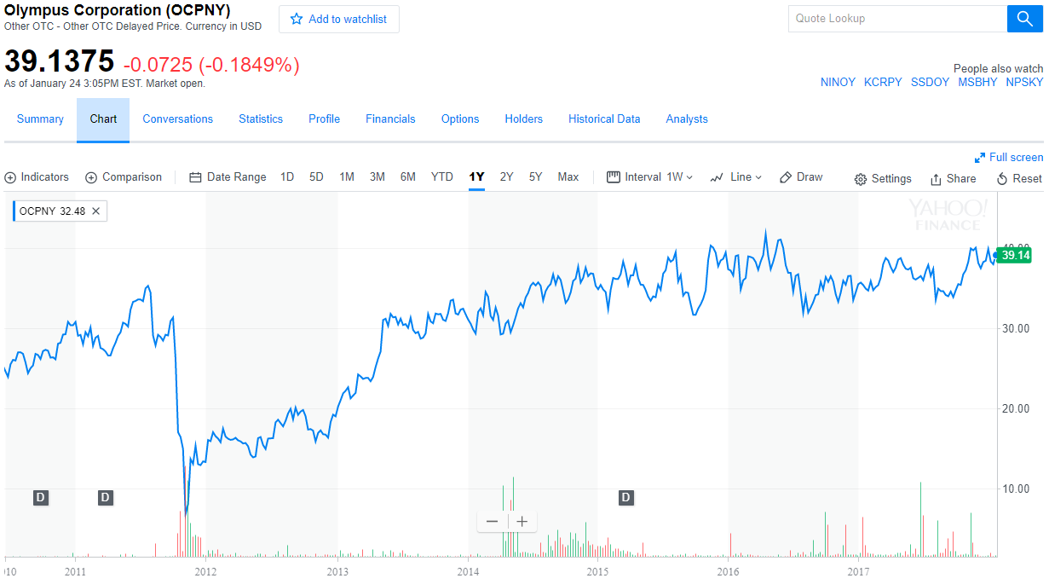
Accounting and Finance Misrepresentation
8 Nov 2011 Olympus admits hiding losses for 20 years. The firm, which has become engulfed by a scandal involving offshore payments that has attracted the attentions of the US Federal Bureau of Investigation, added that it may consider criminal complaints against former executives.

Slide 8
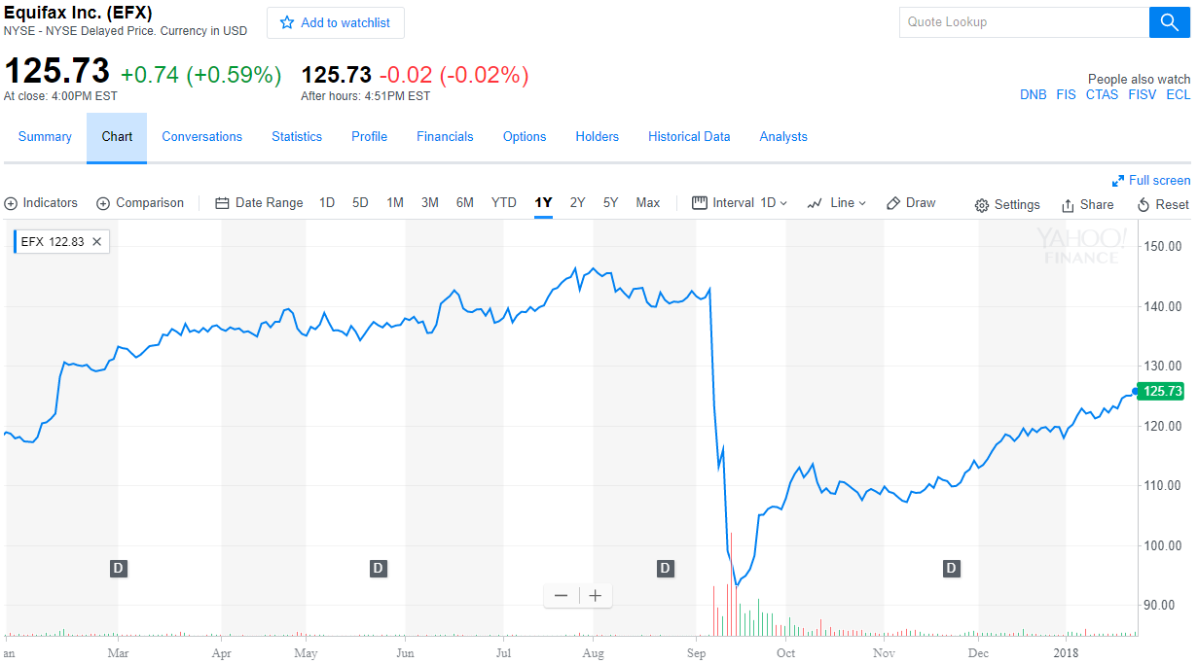
Product Failure, Service Failure or Fraudulent Practice
Credit reporting company Equifax suffered a breach in March, two months before the massive breach that hit as many as 143 million people

Slide 9
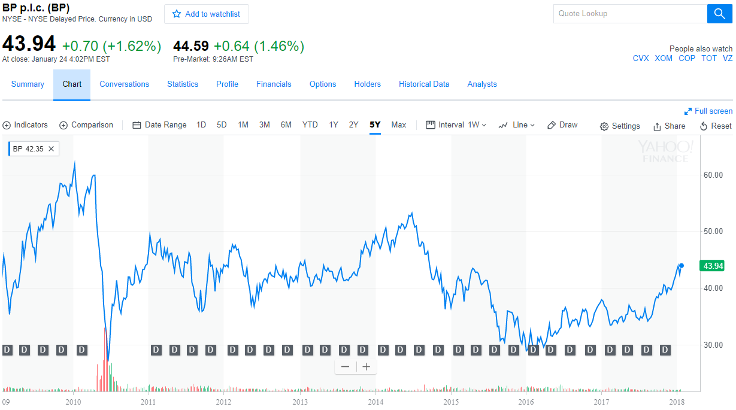
Environmental or Ecological Hazzard
April 21, 2010: The oil rig Deepwater Horizon, under contract with BP, exploded with catastrophic results.

Slide 10
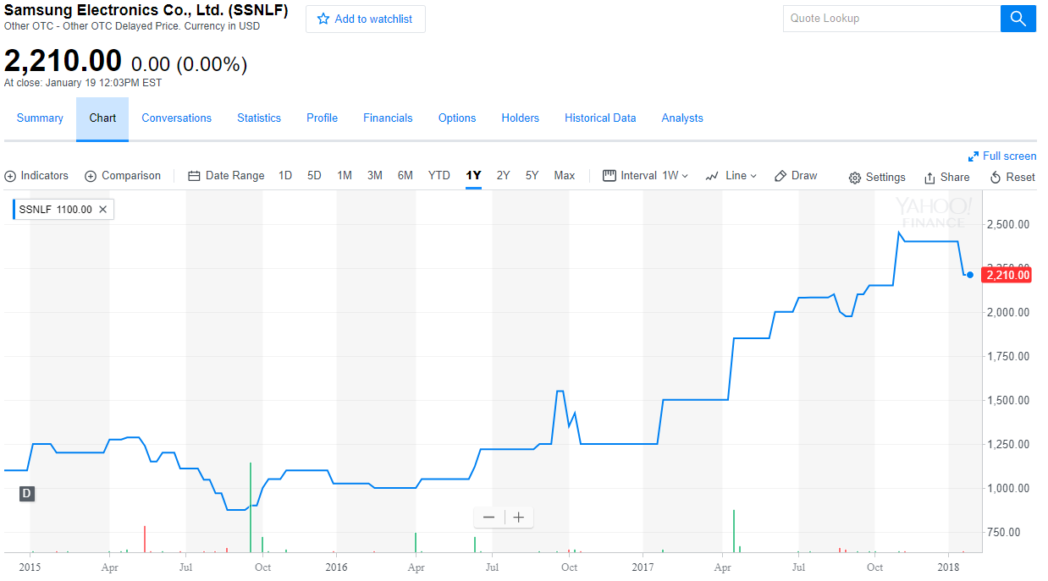
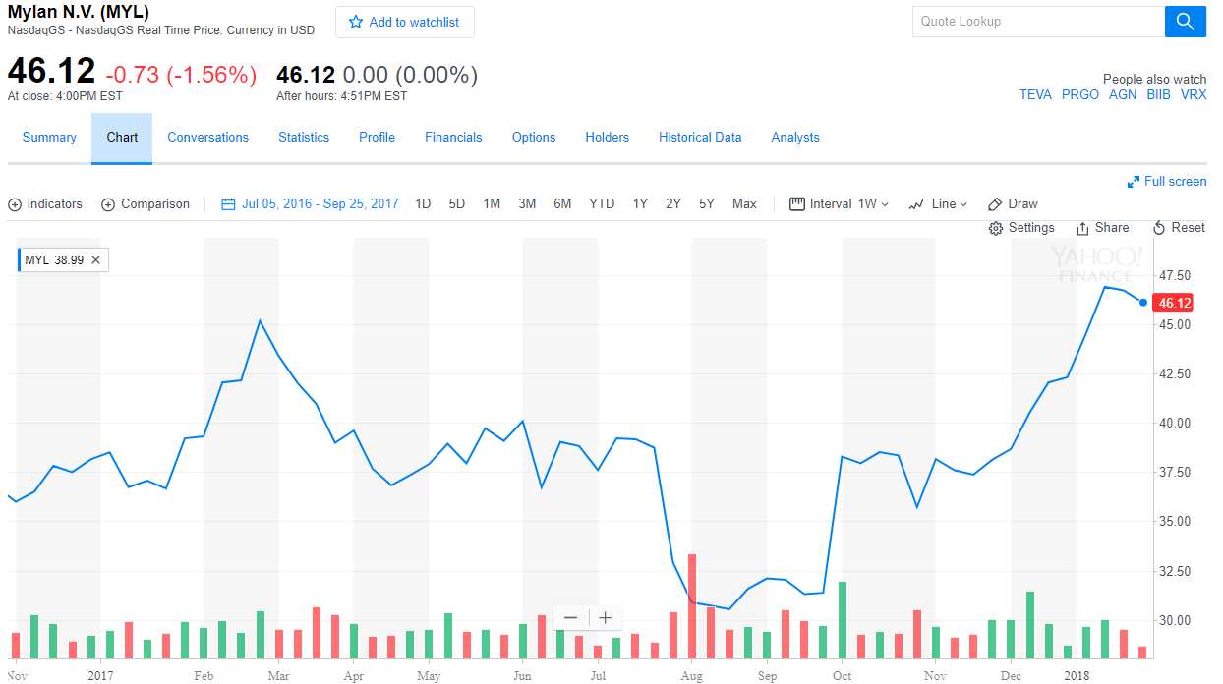
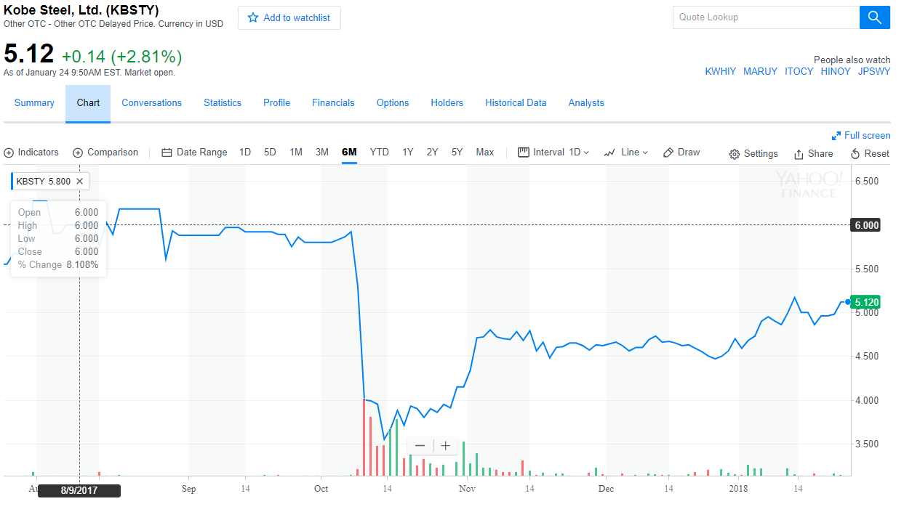
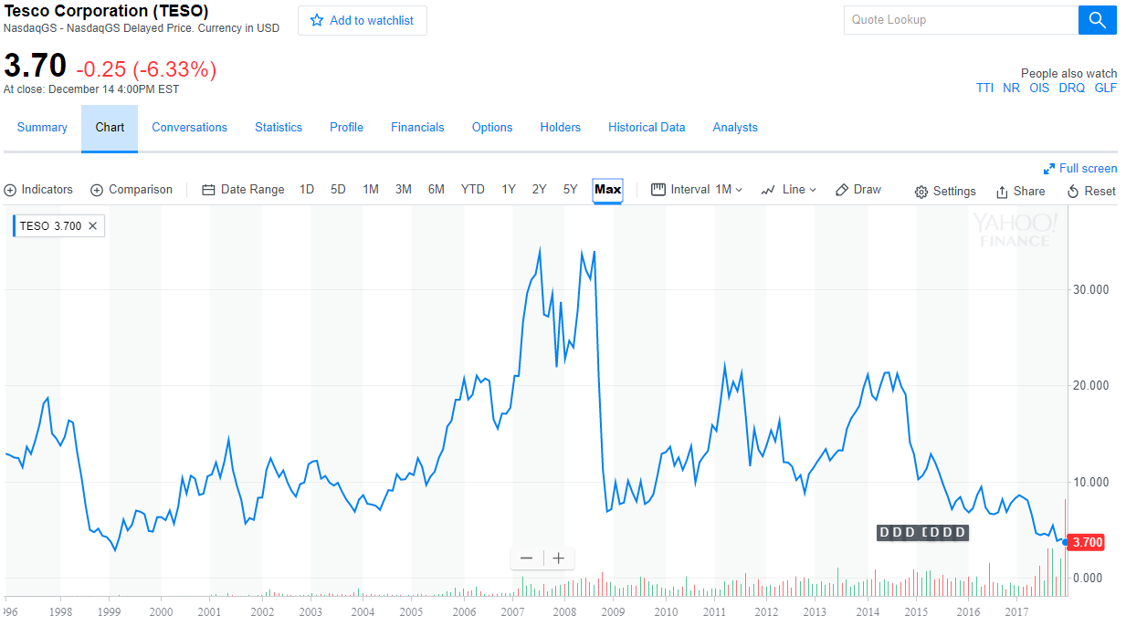
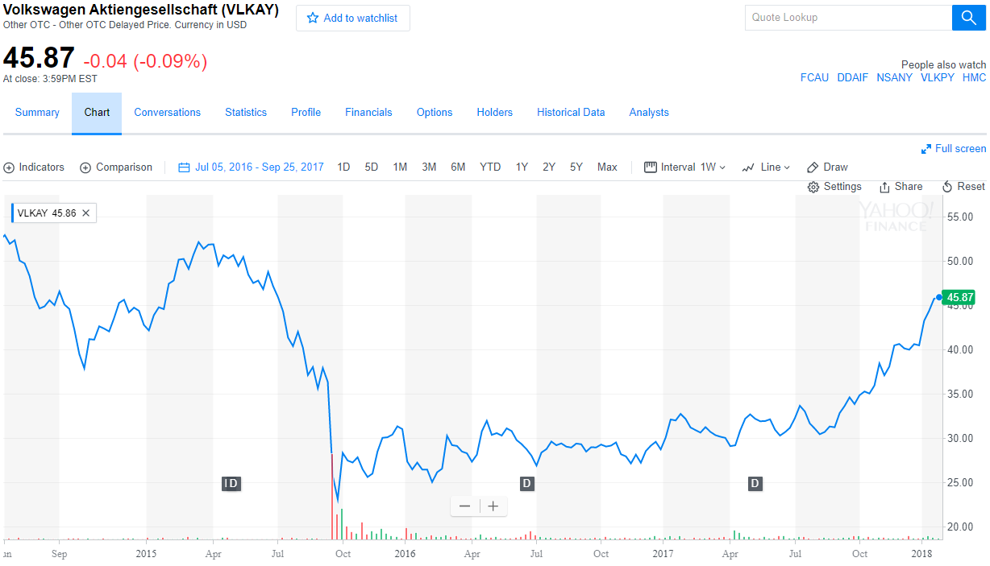
Additional Events
Samsung Galaxy phones explode
Mylan called to hearing for EpiPen pricing
Kobe Steel misrepresent financials
Tesco misrepresent financials
VW falsifies emissions

Slide 11
Process of testing the thesis with a Statistical Model using Machine Learning
Defined Business Logic
A minimum of a 15% decline in price of any security within 1-week is an ‘event’
Any subsequent decline of that same security within 4-weeks of ‘the event’ is the same ‘event’
A 15% increase in the security price above the 26-week low after the ‘event’ is considered ‘the bounce’

Slide 12
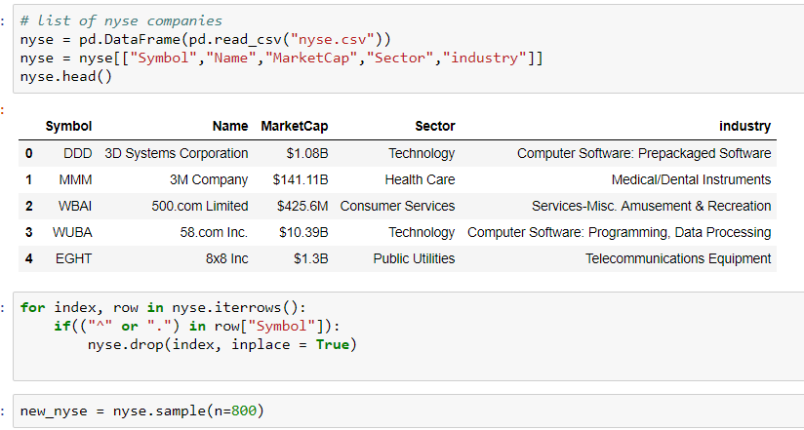
Workflow
First Step
Gather the sources
NYSE stock list
Random sampling of 800 companies

Slide 13
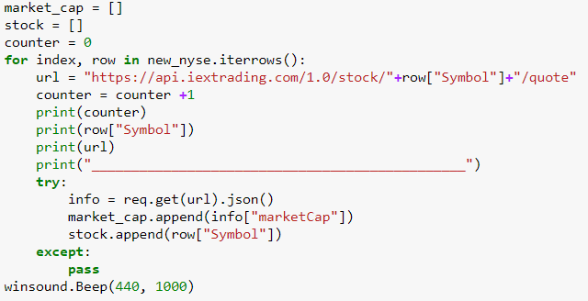
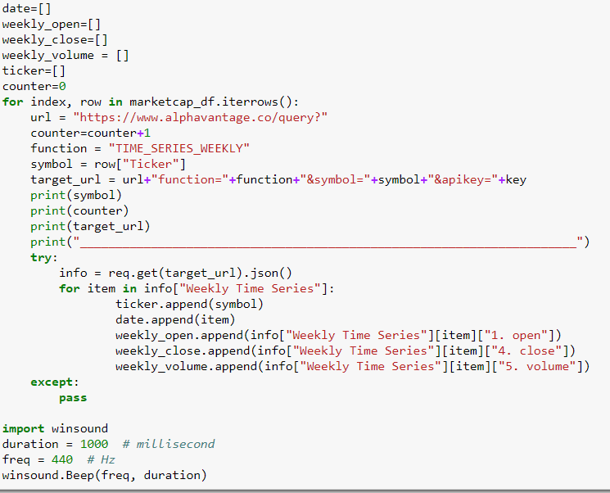
Workflow
Second Step
Gather the time series data
API call to Alpha Vantage Co
API call to IEXtrading

Slide 14
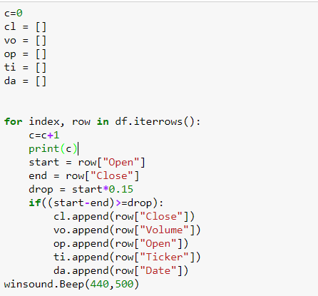
Workflow
Third Step
Find drops in price of 15% or more during the week

Slide 15
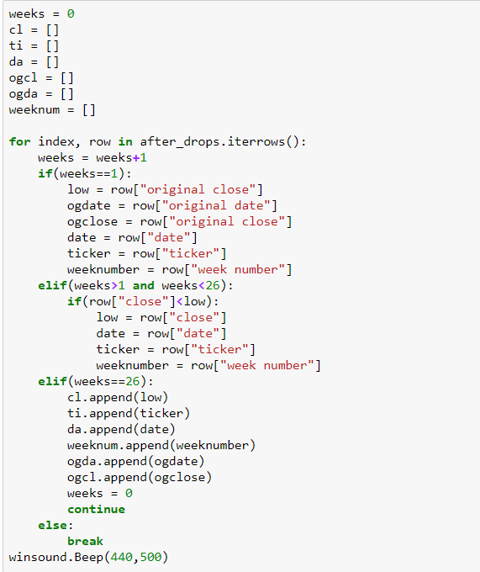
Workflow
Fourth Step
Find the low point after the drop and when it took place

Slide 16
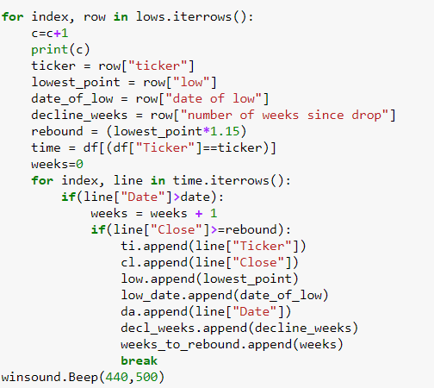
Workflow
Fifth Step
Find out what happens after the low is hit
Record next 26 weeks of data

Slide 17
Workflow
Sixth Step
Find out when we hit the rebound
Rebound point is a 15% increase to the low price

Slide 18
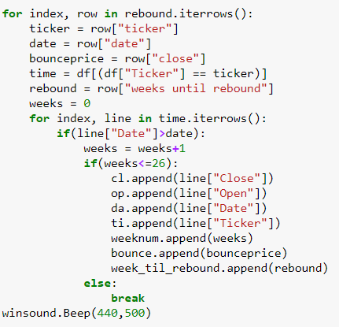
Workflow
Seventh Step
What happens next?
Record the next 26 weeks of data

Slide 19
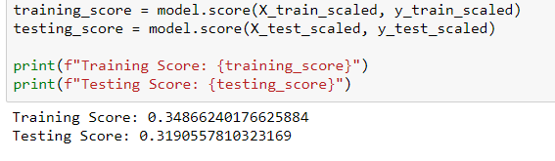
Workflow
Final Step
Machine Learning to predict ROI
6 features
5 Hidden Layers
1000 iterations for……
R² =32%.....

Slide 20
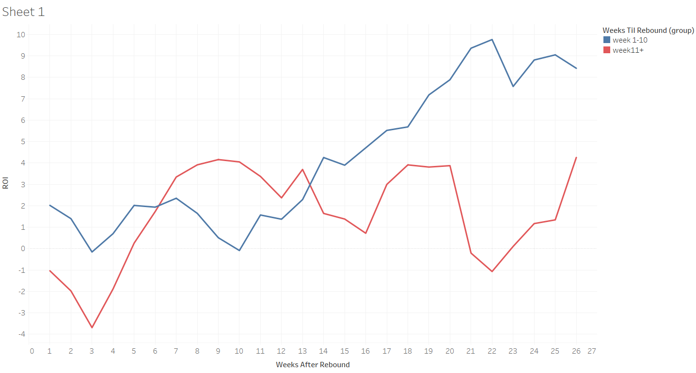
Analysis
Companies with a faster rebound time have a higher ROI at the end of six months

Slide 21
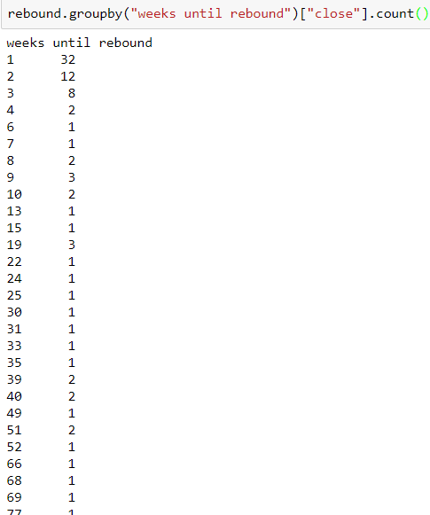
Analysis
Most companies rebound in the first week after hitting the low

Slide 22
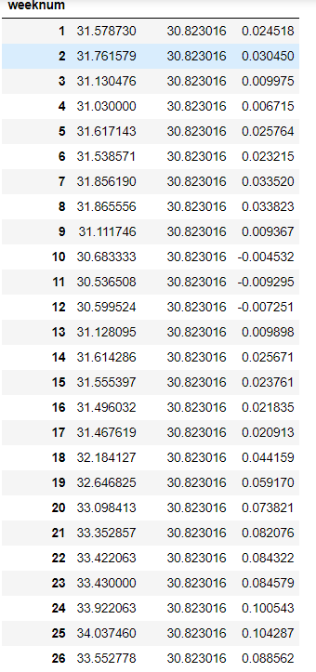
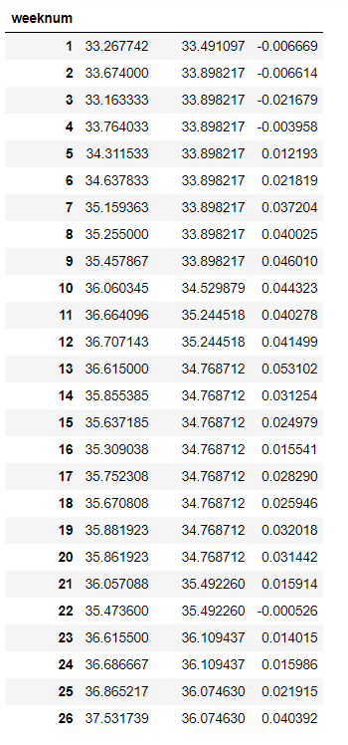
Findings
Rebound within first 10 weeks
Rebound after first 10 weeks

Slide 23
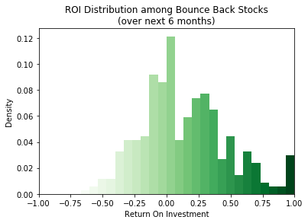
Findings
The positive ROI is obviously a good thing, but here is a different way to look at the results that may be comforting for the risk-averse:
A 30% ROI or better is more likely than losing any money whatsoever
A 40% increase is more likely than a 10% drop
A 60% ROI is more likely than a 25% decline
A 140% return more likely than a 50% drop in value

Slide 24
Findings
Positive results:
Almost all of the stocks bounce back (93.2%) within 6 months
A majority of those bounce backs happen within a 3-week period
This subset features the strongest returns over the next 6 months
Approximately 90% of the bounce backs happen within 10 weeks
This is our threshold for being a worthy buying opportunity
Surprising non-factors:
Length of decline (time)
Magnitude of decline (% of price)
Original stock price

Slide 25
Next Steps
We grouped news events into five categories and developed key words for news article searching:
Product Failure, Service Failure or Fraudulent Practice
Keywords: {'recall', 'failure', 'fraudulent', 'safety+ hazard', 'service+outage', 'breach', 'malfunction’}
Accounting and Financial Misrepresentation
Keywords: {Keywords: 'misrepresentation', 'mistated', 'misrepresented', 'audit', 'fraudulent', 'violation', 'fraud+schemes', 'negligent', 'violation'
Environmental or Ecological Hazzard
Keywords: {'toxicity, 'toxic', 'environmental+hazard', 'ecologic+hazard', 'spill', 'contamination’}
Human Health Hazzard
Keywords: {'spill', 'contamination', 'harmful+exposures', 'food+safety+hazard', 'hazardous+foods', 'microbiological+hazard', 'recall', 'poison', 'poisonous’}
Impact to Key Executives
Keywords: {CEO+health+issue, reputational+risk, sexually+harassed, sexual+harassment, executive+impropriety, personal+risk+taking, lack+of+governance}

Slide 26
Next Steps
Find out if the severity of the news event influences results
Calculate article count & average sentiment during week of major decline
Recording the type of event based on keyword search
Further testing
Test more datasets to further confirm our findings
Drill down criteria to find subsets that perform even better than the average
Test variables such as past volatility & volume
Automate a process to scan for these events
Create an app to detect events, give an alert after the bounce back
Set up a bot to make buy/sell orders based on our criteria

Slide 27
Questions?
Harshil Patel, Sean Slavin, Craig Bauer, Mariah McLaughlin

